Slide 1




What are the 3 basic need of Life ?

Slide 2



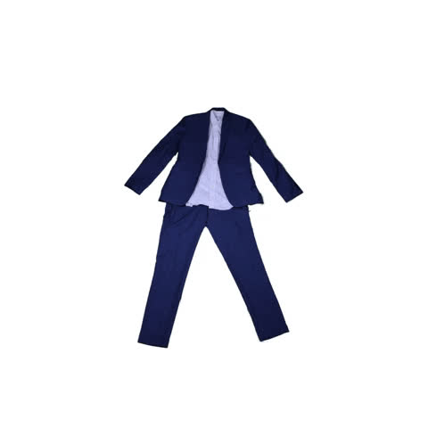
3 Basic needs of Life
Food
Clothing
Shelter

Slide 3

Surplus Food Donation System
Presented By :
Omkar Thopte
Rohit Wagh
Akash Verma
Basant Bhagat

Slide 4


1
Abstract
2
Objective of Project
Contents
3
Literature survey
4
Problem Definition
5
Architecture of project
6
Applications
76
Advantages
8
Conclusion

Slide 5


Abstract
Food donation system is a process usually led by food donation organizations that are collecting food from businesses and individuals or from the ones with excess of goods, storage it, distribute it to the food banks and finally redirect it towards people in community that have a deficit of particular goods.

Slide 6

Objective of Project
The main objective of a Wastage Food Donation System is to **Reduce food waste** by efficiently redistributing surplus and edible food to individuals and families in need, thereby helping to alleviate hunger and promote sustainability.

Slide 7
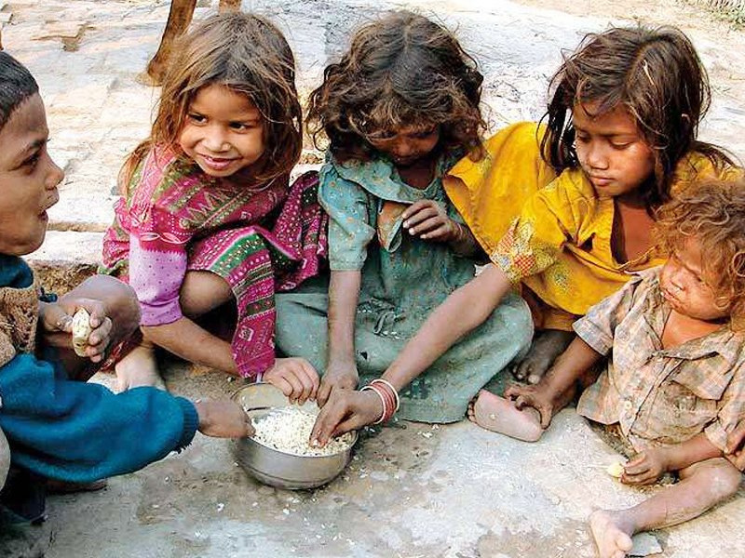


India Is Experiencing An Alarming Rate Of Hunger
Following a suo motu investigation into three deaths in a single family within six months in Bokaro in 2020, the Jharkhand High Court has questioned the state government regarding the "definition of hunger death" and the "actual number of hunger deaths," if any.
Bhukkhal Ghasi, 42, passed away in March 2020, and his daughter and son also passed away within the following six months. Experts in food security referred to these deaths as "hunger deaths," but the state denied it, claiming that all of them were caused by diseases. The matter became a PIL after it was brought to the court's attention.

Slide 8
Literature survey
Title
Author
Description
Accuraccy
Hassan Hajjdiab; Ayesha Anzer; Hadeel A. Tabaza; Wedad Ahmed
Reducing Food Waste
A Food Wastage Reduction Mobile Application
Donor Sources
75.47
Recipient Organizations:
Development of Leftover food management system using efficient hunger search techniques
Food waste management, SGWC, FWDM, SGB (Smart Garbage bin).
K. Jayalakshmi S.Pavithra C. Aarthi
82.01

Slide 9

Problem Definition
"Food wastage and hunger coexist in our community, highlighting the need for an efficient waste food donation system."

Slide 10
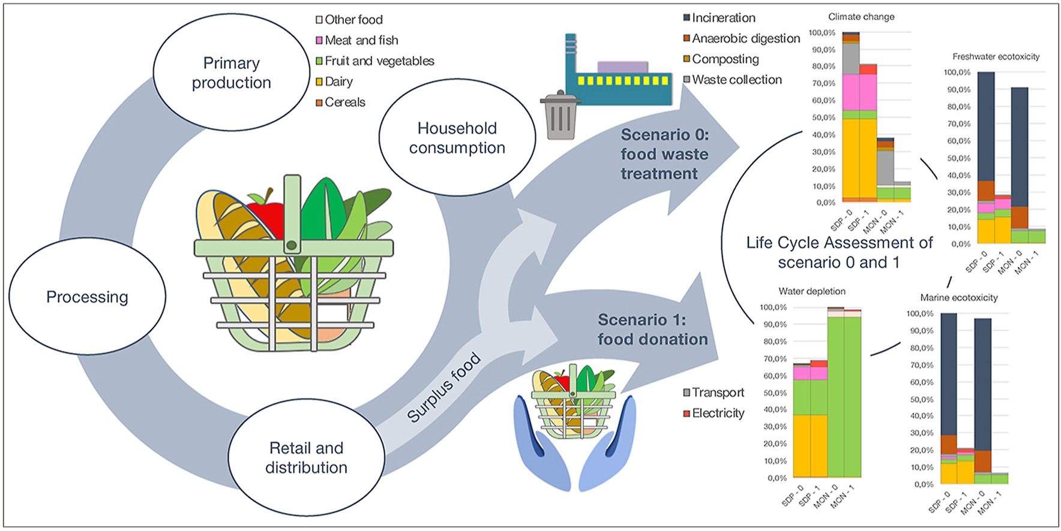
Architecture of project

Slide 11
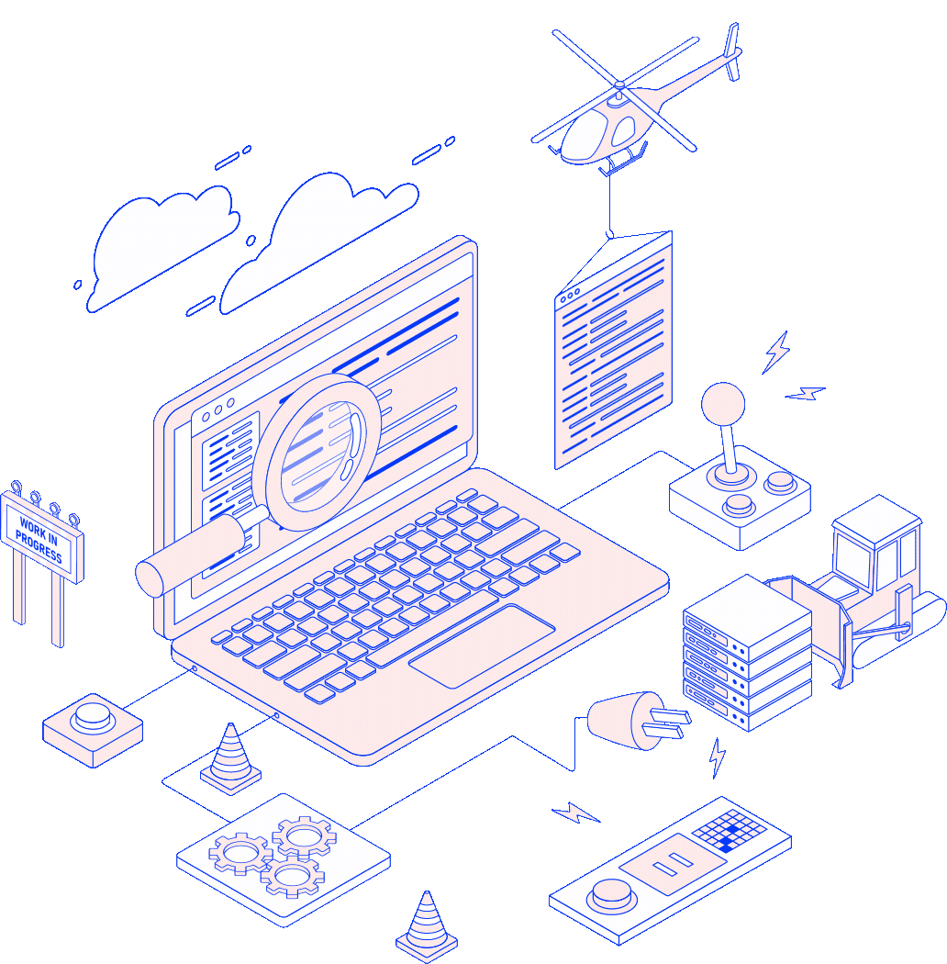
Applications
Restaurants and Cafes: These businesses can donate surplus food to GIVE Points, reducing waste and fostering community goodwill.
Grocery Stores and Supermarkets: Unsold but still edible food items can be donated to given points instead of being discarded.
Event Planners: After events, such as weddings or conferences, excess food can be donated to help those in need.
Catering Companies: Leftover food from catering events can be donated to ensure it doesn't go to waste.
Individuals: People can donate non-perishable or excess food items they have at home.

Slide 12


Advantages
Reduces Food Waste: The primary advantage is the significant reduction of food waste. Surplus and unused food that would otherwise be discarded is redirected to those in need.
Addresses Food Insecurity: GIVE Points provide a vital source of food for individuals and families facing food insecurity, helping to alleviate hunger.
Environmental Impact: By diverting food from landfills, these systems help reduce greenhouse gas emissions and alleviate the environmental burden of food waste.
Cost Savings: Businesses can save money by donating surplus food rather than incurring disposal costs. It can also lead to potential tax benefits in some regions.
Community Building: GIVE Points foster a sense of community by bringing together donors, volunteers, and recipients in a shared effort to help others.

Slide 13


General
Expectations
Responsive Design: The application should be responsive and work well on various devices, including desktops, tablets, and smartphones.
User-Friendly Interface: The user interface should be intuitive and easy to navigate for both managers and customers.
Authentication: User authentication should be secure, and managers should have administrative privileges.
Real-Time Updates: Notifications for new orders, reservations, or customer feedback should be in real-time, if possible.
Scalability: The application should be designed to handle potential growth in terms of menu items, orders, and user activity.
Data Persistence: Data, such as menu items, orders, and reservations, should be stored securely and persistently, typically in a database.
Testing and Quality Assurance: Thorough testing should be conducted to ensure the application functions correctly and is free of bugs.
Deployment: The application should be successfully deployed to a hosting platform for public access.
Maintenance and Updates: Ongoing maintenance and updates should be performed based on user feedback and evolving business requirements.

Slide 14

Conclusion
Waste food donation systems like given points reduce food waste, alleviate hunger, benefit the environment, and foster community engagement. They are a win-win solution for society, addressing critical issues while promoting sustainability and goodwill.

Slide 15
References
01
https://www.researchgate.net/publication/321914425_The_Challenges_of_Establishing_Food_Donation_System#:~:text=Food%20donation%20system%20is%20a,a%20deficit%20of%20particular%20goods.
02
https://www.sciencedirect.com/science/article/abs/pii/S0959652621000330
03
https://ijcrt.org/papers/IJCRTO020006.pdf
04
https://www.ijraset.com/research-paper/food-waste-management

Slide 16


Thank you for listening!
Ask Us
if you have questions.

